Slide 1
Maximizing Profitability Through Smart Pricing Presentation

Slide 2
Agenda
Introduction
Objectives:
Step 1 Model development
Step 2 Finding the best Model
Step 3 Calculate absolute percent error
Step 4 Model the business using Power model
Summarize and take aways

Slide 3
Introduction
Business problem:
Top Good Pest Zapper is a company specializing in the manufacturing of electric pest zappers. This year, they have decided to directly market and sell their products, rather than relying on a partner. In response to the highly competitive market landscape, Top Good aims to leverage statistical models to refine their pricing and marketing strategies, enabling more informed decision-making and a stronger market presence.

Slide 4
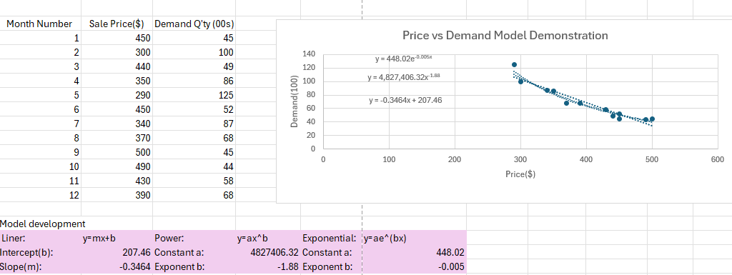
Step 1 Model development
Based on historical sales data, including price and demand trends from the past year, the marketing team has developed three predictive models to compare and identify the most effective one.
Models: Linear, power, exponential

Slide 5
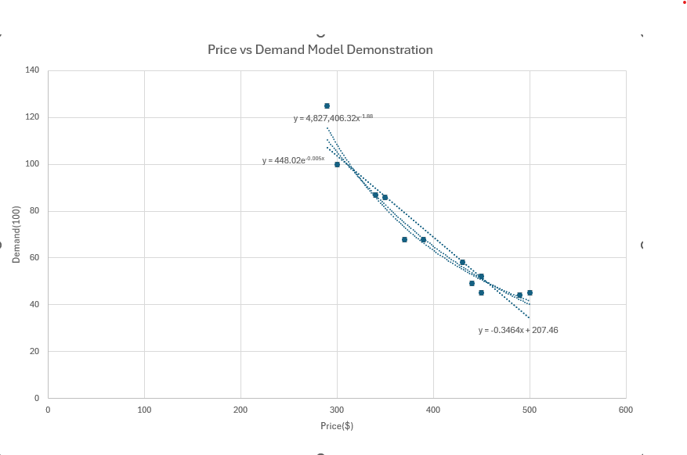
Step 2 Finding the best model
Findings:
Among the line graphs from Linear, Power, and Exponential Models, the Power model appears to be more accurate, as it aligns better with the actual demand in the price vs. demand relationship.

Slide 6
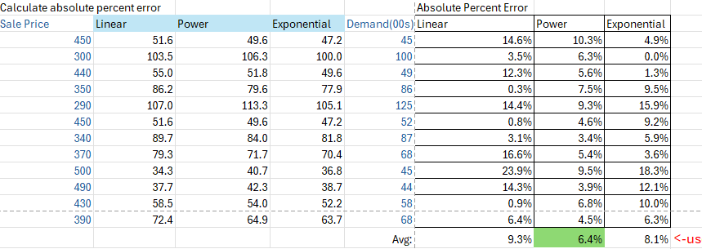
Step 3 Calculate Abs Percent Error
Findings:
Among the three models, Power model has the smallest absolute percent error, meaning we can rely on this model for further actions.

Slide 7
Step 4 Model the Business(Power model)
y = ax^b
x = price
a = 4827406.32
b = -1.88
Cost per unit: $250
Findings:
With a fixed cost of $250 per unit, the graph illustrates that profit increases up to a price of $530, after which it slightly decreases and remains steady thereafter.

Slide 8
Summarize & take aways
Used techniques: MS Excel (graph, VLOOKUP ), PowerPoint
Best predictive model: power model
Inventory Strategy: an annual demand of 3,640 units is the optimal quantity for maximizing profit. Deviating from this amount—either too few or too many units—is not recommended.
Pricing strategy: price the product at $530 per unit will maximize annual profit.
Constrain: optimal pricing and inventory subject to change if the cost of unit changes.

Slide 9
Thank you
Lei Liu
408-805-6749
lauraliu1117@gmail.com

